Slide 1



ANNUAL MEMBERSHIP
CENSUS
kosovo
2024

Slide 2

MEMBERSHIP AND physiotherapy workforce
Percentage of physiotherapists who are members of a World Physiotherapy member organisation compared with total physiotherapy workforce
100%
Percent
of physiotherapists in Kosovo are members of the Oda e Fizioterapeutëve të Kosovës/Chamber of Physiotherapists of Kosovo in 2024.
© World Physiotherapy 2024

Slide 3
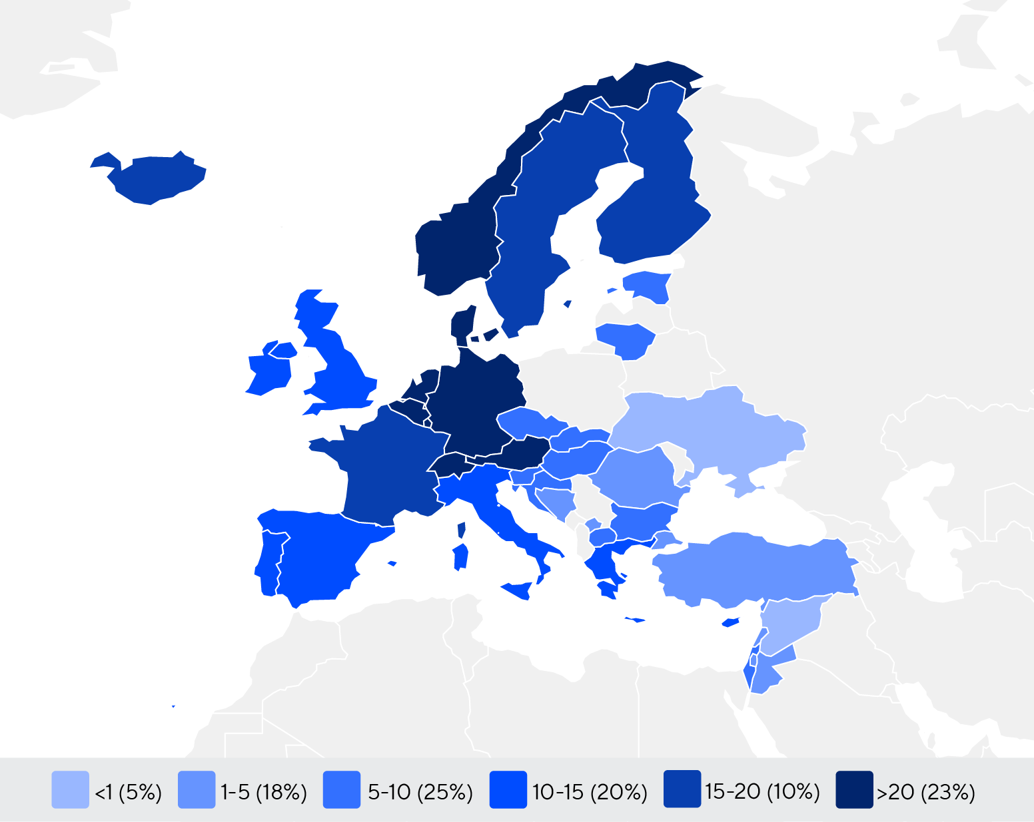
MEMBERSHIP AND physiotherapy workforce
PHYSIOTHERAPISTS PER 10,000
POPULATION IN THE REGION
Number of practising physiotherapists per 10,000 population IN
EUROPE
4.48
is the number of practising physiotherapists per 10,000 population in Kosovo
in 2024.
© World Physiotherapy 2024

Slide 4


GENDER
IN THE COUNTRY/TERRITORY
GLOBALLY
58%
58%
58%
of physiotherapists in the Chamber of Physiotherapists of Kosovo are female
of physiotherapists in Kosovo are female
of the individual members of World Physiotherapy member organisations are female
IN THE EUROPE REGION
61%
64%
65%
of the global physiotherapy workforce is female
of physiotherapists in member organisations in the Europe region are female
of physiotherapists in the Europe region are female
© World Physiotherapy 2024

Slide 5


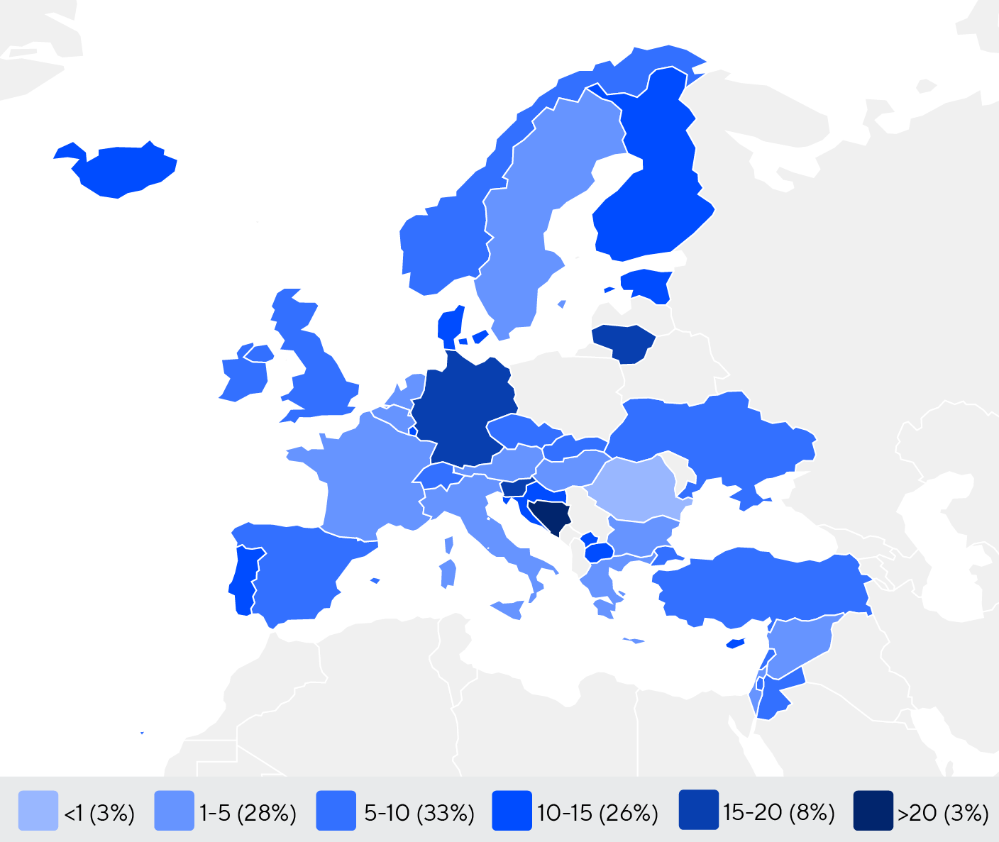


ENTRY LEVEL EDUCATION PROGRAMMES
Number of entry level education programmes per 5,000,000 population
11.39
entry level education programmes in Kosovo per
5 million population in 2024
7.46
is the average number of entry level education programmes per 5 million population in the Europe region in 2024
Bachelor’s degree is the minimum qualification required to practice in Kosovo
© World Physiotherapy 2024

Slide 6








PHYSIOTHERAPY practice
Have specialty interest groups which are recognised by World Physiotherapy
Provide CPD for members
There are support personnel who work with physiotherapists
73%
56%
71%
82%
46%
61%
Kosovo
Kosovo
Kosovo
Europe
Global
Europe
Global
Europe
Global
Membership is required to practice
Have postgraduate programmes
Have access to PhD programmes
22%
18%
95%
77%
76%
50%
© World Physiotherapy 2024
Kosovo
Kosovo
Kosovo
Europe
Global
Europe
Global
Europe
Global

Slide 7
RESPONSE TO SURVEY IN 2024
Africa region |  | Asia Western Pacific region |  | Europe region |  | North America Caribbean region | South America region
Angola | Sudan | Afghanistan | Papua New Guinea | Austria | Lebanon | Bahamas | Argentina
Benin | Tanzania | Australia | Philippines | Belgium | Liechtenstein | Barbados | Brazil
Cameroon | Togo | Bahrain | Saudi Arabia | Bosnia and Herzegovina | Lithuania | Bermuda | Chile
Congo (Democratic Republic) | Uganda | Bangladesh | Singapore | Bulgaria | Luxembourg | Canada | Colombia
Eswatini | Zambia | Bhutan | Sri Lanka | Croatia | Malta | Guyana | Costa Rica
Ethiopia | Zimbabwe | Cambodia | Taiwan | Cyprus | Netherlands | Haiti | Dominican Republic
Ghana |  | Hong Kong | Thailand | Czech Republic | Norway | Jamaica | Ecuador
Ivory Coast |  | India | United Arab Emirates | Denmark | Palestine | Panama | Guatemala
Kenya |  | Indonesia | Vietnam | Estonia | Portugal | Puerto Rico | Mexico
Madagascar |  | Japan | Yemen | Finland | Romania | St Lucia | Peru
Mali |  | Korea (Republic of) |  | France | Slovakia | Suriname | Uruguay
Mauritius |  | Kuwait |  | Germany | Slovenia | Trinidad and Tobago | Venezuela
Morocco |  | Macau |  | Greece | Spain | United States
Namibia |  | Malaysia |  | Hungary | Sweden
Niger |  | Mongolia |  | Iceland | Switzerland
Nigeria |  | Myanmar |  | Ireland | Syria
Rwanda |  | Nepal |  | Israel | Turkey
Senegal |  | New Zealand |  | Italy | Ukraine
Sierra Leone |  | Oman |  | Jordan | United Kingdom
South Africa |  | Pakistan |  | Kosovo | Lebanon
Responses to the annual membership census were received from World Physiotherapy member organisations in these countries/ territories in 2024.
© World Physiotherapy 2024

Slide 8



STAY IN TOUCH
DISCLAIMER
The data in this report is based on responses to the annual membership census (AMC) sent to World Physiotherapy’s member organisations.
The AMC was sent to 125 member organisations, of which 120 responded, representing a 96% response rate. In the Europe region 39 out of 42 member organisations submitted their AMC data, this represents a 93% engagement rate in the region. This is consistent with previous years’ response rates and demonstrates strong engagement between World Physiotherapy and its member organisations. The census date was 30 June 2024.
Some data in this report has been collated from other sources available to World Physiotherapy.
If you have any questions or concerns, or want to make changes to the data for your country/territory, please contact membershipcensus@world.physio.
Find out more about physiotherapy around the world:
Global profiles
Follow
World Physiotherapy on social media
@WorldPhysio1951
Discover
World Physiotherapy’s website: www.world.physio
© World Physiotherapy 2024

